Slide 1

The B.O.M.: Chiel Peters, Cindy Berghuizen, Mary Gouseti, Omar Pakker
Software Architecture
Review of W1's Architecture

Slide 2

Overview
Conclusions from questions
  Capturing stakeholder's concerns
  Identifying requirements & decisions
  Reviwing the choice of viewpoints
Scenarios
Analysis
The B.O.M.

Slide 3
  Capturing Stakeholder's Concerns
The B.O.M.

Slide 4
  Identifying requirements & decisions
The B.O.M.

Slide 5
l
  Reviwing the choice of viewpoints
The B.O.M.

Slide 6
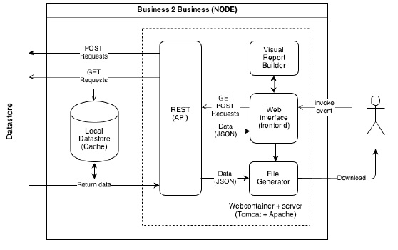
  Reviwing the choice of viewpoints
The B.O.M.

Slide 7
Senarios – Decoupling B2B / B2C
Attribute | Availability
Environment | Normal operations
Stimulus | B2B or B2C failure
Response | Failure of either one does not influence the other.
 | Architectural Decision | Sensitivity | Trade-off | Risk | Non-risk
 | Decoupling | S1 | T1
 | Different API | S1 | T2 |  | N1
S1: If both modules run on the same server they will still fail if the server crushes. T1: May lose similar requests' optimization => Performance vs Availability. T2: Redundant code => Modifiability vs Availabilty. N1: There is no single point of failure.
Reasoning | Decoupling B2B/ B2C => B2B fails B2C stays unaffected and vice versa.
The B.O.M.

Slide 8
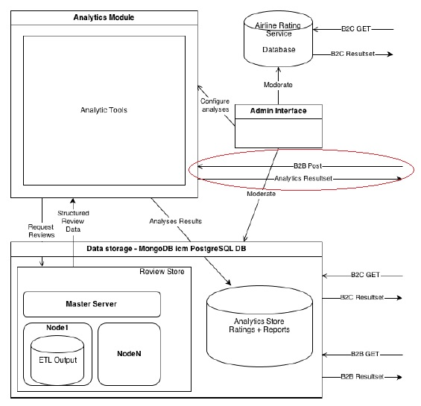
Senarios – Peak Load on Analytic Module
The B.O.M.

Slide 9
Senarios – Peak Load on Analytic Module
Attribute | Performance
Environment | Normal operations
Stimulus | Recalculating ratings/ reviews
Response | B2B latency < 10 sec.
 | Architectural Decision | Sensitivity | Trade-off | Risk | Non-risk
 | Recalculate 1-2 times a day (Implicit) |  |  | R1
 | B2B accesses analytics directly (Implicit) |  | T1
R1: Recalculating creates a peak load on the analytics module which may increase B2B latency. T1: Custom queries => Functionality vs Performance and even availability.
Reasoning | Recalculating on a time frame + Direct access to analytics => Undesirable response time
The B.O.M.

Slide 10

Questions?
Ball of Mud is a reference to the Software Architecture
“Big Ball of Mud”.
This is an architecture without a clear structure.
The B.O.M.

